Slide 1

Market Basket Analysis
Team – Significant
by Taraka Guntupalli Laxmi Priyanka Ponduri Yasaswini Allaparthi Mohitha Lakshmi Dayana

Slide 2
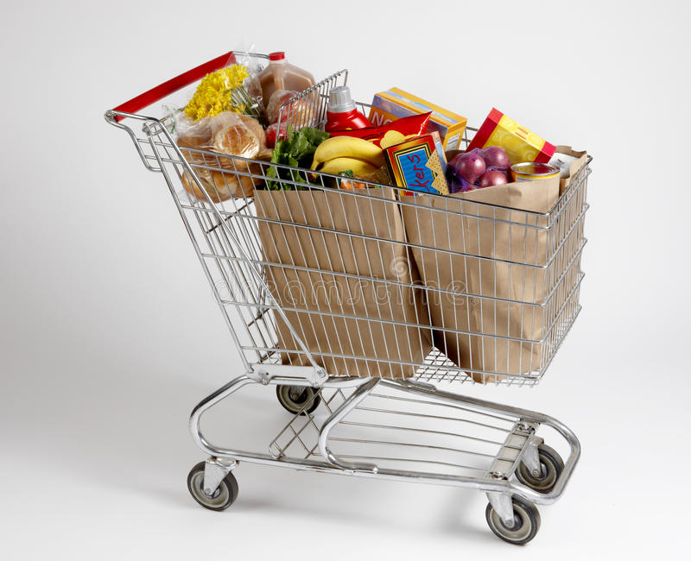
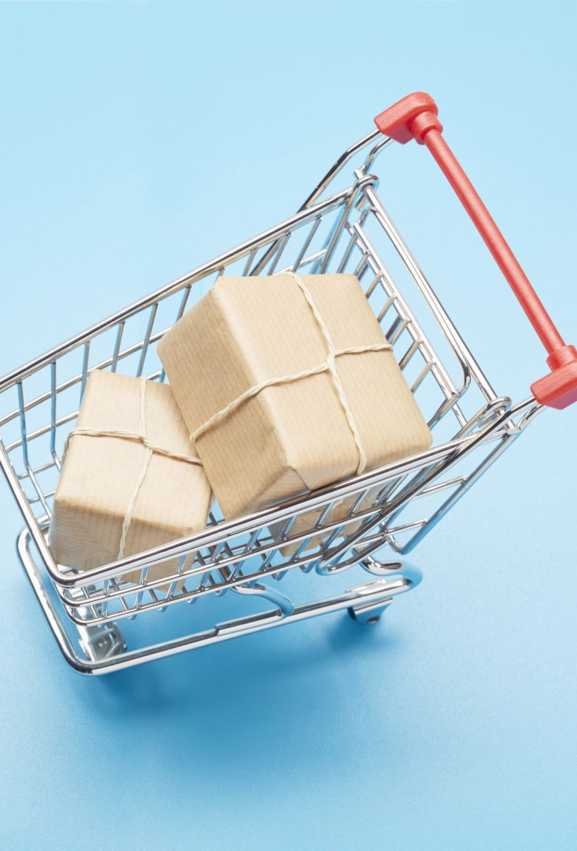
Introduction
Market Basket Analysis is a technique used by businesses to understand the relationships between different products that customers purchase together. It involves analyzing transactional data to identify which items are frequently purchased together and to identify patterns in customer purchasing behavior.
Objective: To analyze customer shopping data and discover patterns and relationships between products.
Data set: ‘customer_shopping_data.csv’
Method: Market Basket Analysis using Apriori Algorithm.
Applications: Product Analysis, inventory management, sales promotions, etc.

Slide 3
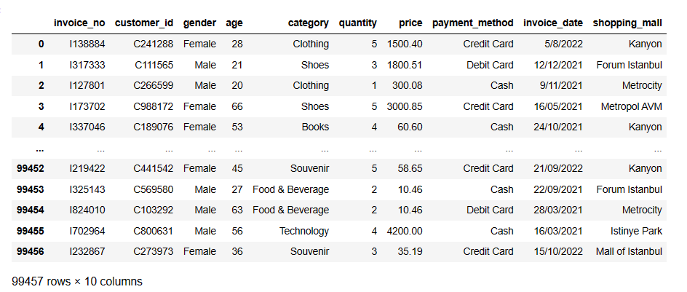
Dataset
The dataset Consist of 99457 rows and 10 columns.
The basic libraries used for the analysis :
Pandas: For data manipulation and analysis
Numpy: For Numerical operations
Seaborn: Statistical graphics
mlxtend: For market basket analysis using the Apriori Algorithm.

Slide 4
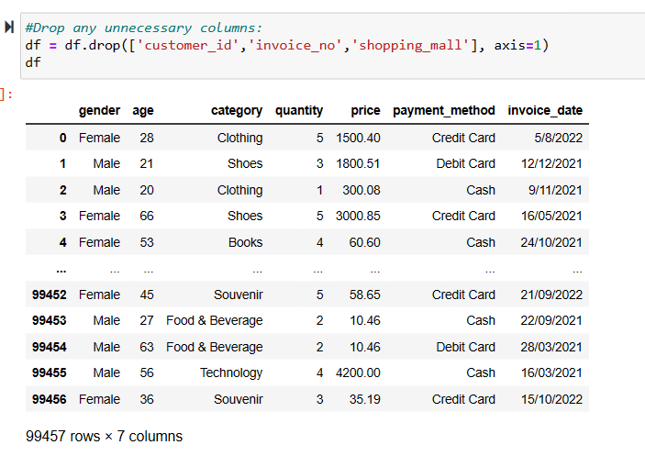
Data Preparation
Import necessary Libraries
Load the dataset: customer_shopping_data.csv
Clean the dataset: Drop unnecessary columns
Feature engineering: Invoice date, age categories, and total price

Slide 5
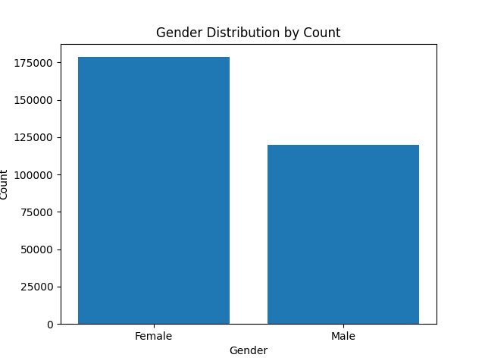
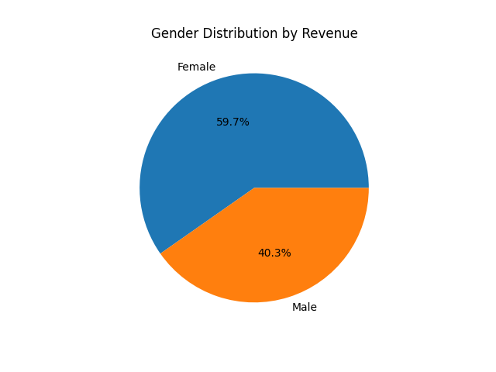
Data Visualization – Gender Distribution
Bar chart for average revenue by categories relative to gender.
Pie chart for gender distribution by revenue.

Slide 6
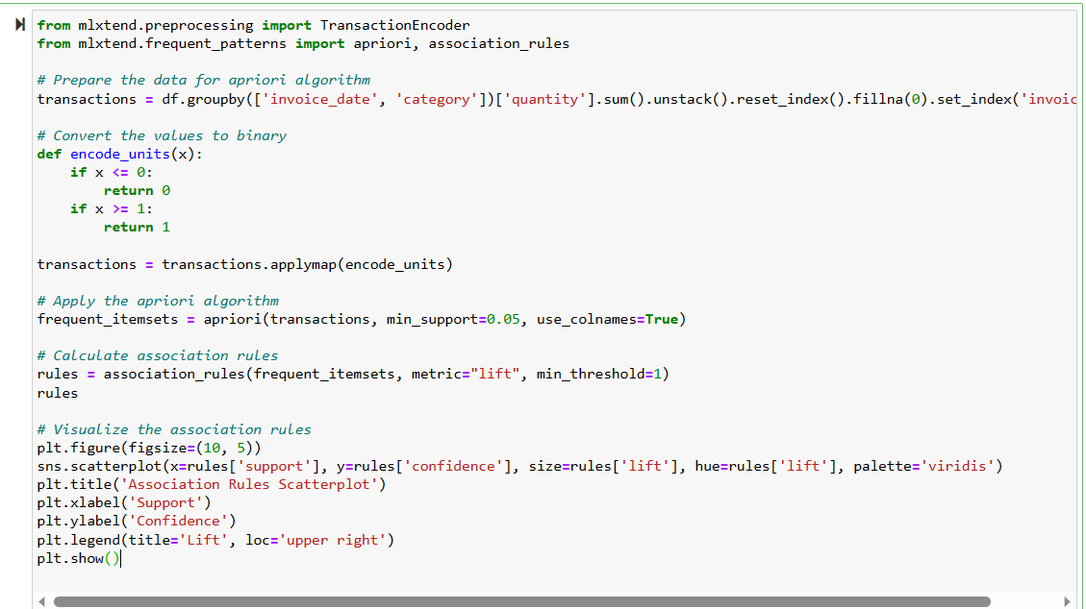
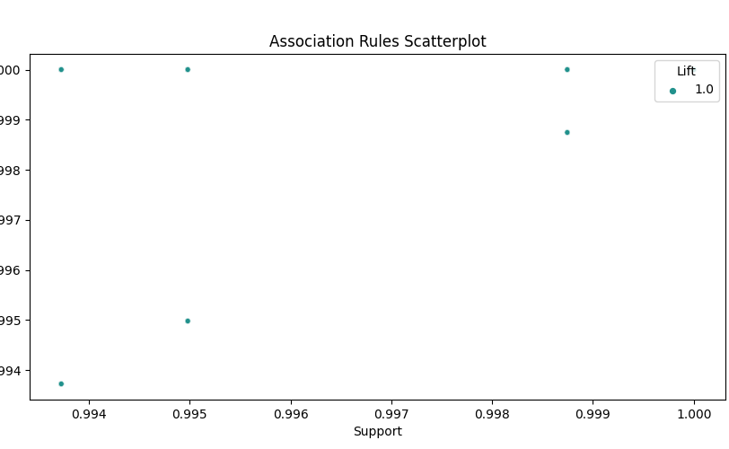
Market Basket Analysis – Apriori Algorithm
Prepare data for the algorithm: Convert transaction data to binary format.
Apply the apriori algorithm: Frequent itemsets with min_support = 0.05
Calculate association rules: Using lift as the metric, with min_threshold = 1
Insights: Identifying product combinations with high support, confidence and Lift.
Visualize the association rules using a scatter plot.

Slide 7
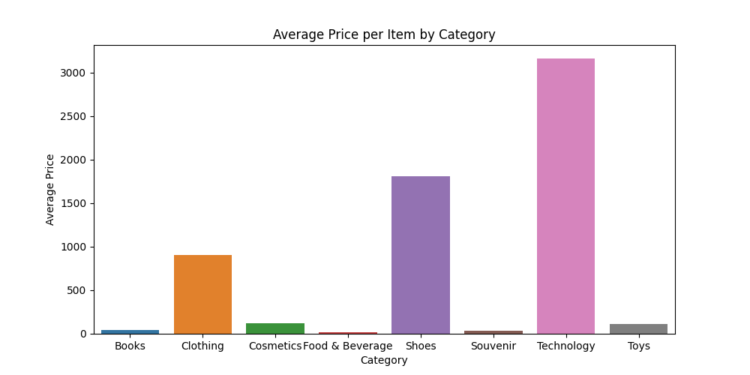
Top Categories Analysis
Bar charts for top categories by quantity and revenue.
Insights: Identifying the most popular and profitable product categories.
Applications: Inventory management targeted marketing and pricing strategies.

Slide 8
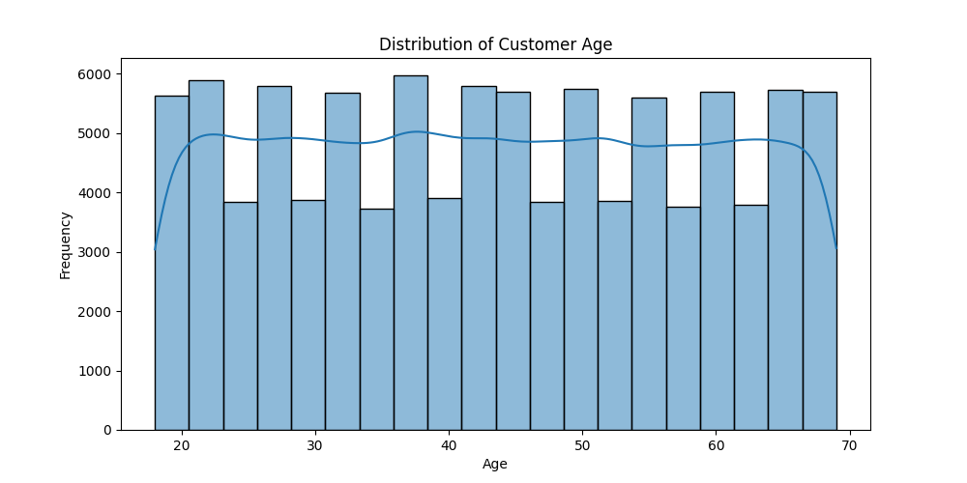
Customer Age Distribution
Histogram for the distribution of customer age.
Insights: Understanding the age demographics of Customers.

Slide 9
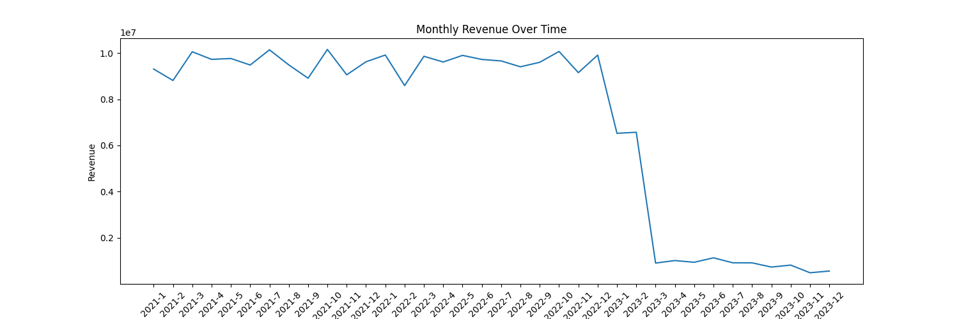
Time Series Analysis
Line plot for monthly revenue over time.
Insights: Analyzing revenue trends and seasonality.
Applications: Forecasting future revenue, planning promotions and inventory management.

Slide 10
Other Visualizations
Bar chart for revenue by age category.
Bar chart for total revenue by payment method
Bar chart for average price per item by category.
Box Plot for total price by category.
Insights: Understanding customer preferences, payment habits and price points.

Slide 11
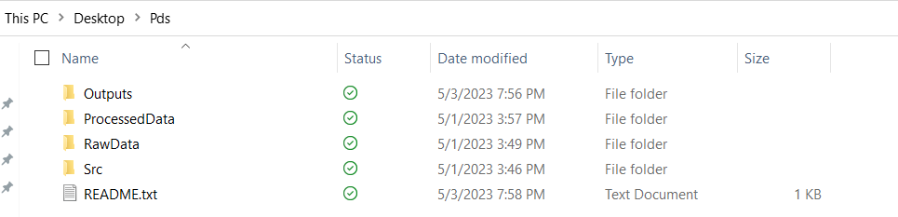
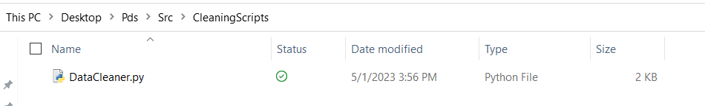
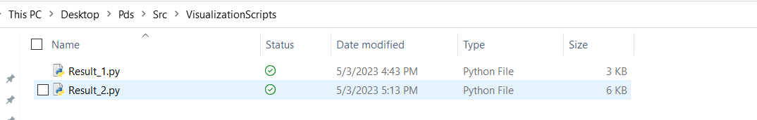
Reproducible Workflow
Stage 1: Data Collection
Stage 2: Data Processing
Stage 3: Data Analysis

Slide 12
Conclusion
Market Basket Analysis using the Apriori Algorithm is a powerful technique that can help businesses analyze customer shopping data and discover patterns and relationships between products. It can provide insights into customer behavior, popular and profitable product categories, age demographics, revenue trends, and seasonality, which can be used for inventory management, targeted marketing, pricing strategies, forecasting future revenue, planning promotions, and inventory management.

Slide 13


